Slide 1
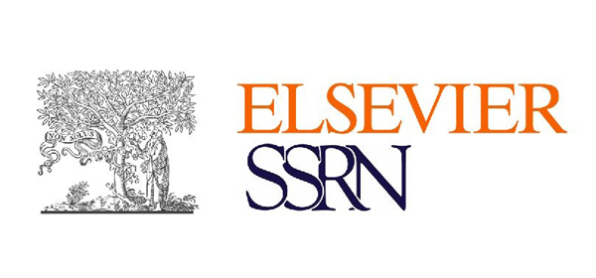



International Conference on Recent Advances in Science, Technology, Engineering and Management
[ICRASTEM-2K23]
Live Capturing Based Image Segmentation using Mask R-CNN
By
MR. K. JEEVAN RATNAKAR
V. Veda Sri , S. Aasritha , V. Venkata Deepthi
Article ID: ic2k23-it-022 Date: 11/04/2023

Slide 2
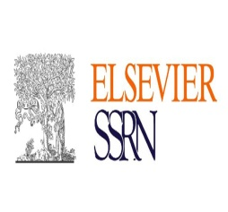

VVIT, ICRASTEM-2K23 Live Capturing Based Image segmentation using Mask R-CNN
Outline:
Abstract
Introduction
Methods, Implementation
Results
Conclusion, Limitations, Future Scope
References
Acknowledgements
Article ID: ic2k23-it-022 11/04/2023 -2-

Slide 3
VVIT, ICRASTEM-2K23 Live Capturing Based Image segmentation using Mask R-CNN
ABSTRACT
Image segmentation is a critical process in computer vision. It involves dividing a visual input into segments to simplify image analysis. In our project we are working with image segmentation with traffic images. Traffic-based image segmentation is a technique used to identify and isolate vehicles, pedestrians, and other objects in traffic scenes captured by cameras. Here we used mask rcnn for image segmentation. The algorithm uses convolutional neural networks to identify objects of interest in traffic scenes and segment them accurately. This project helps in automating the signal change irrespective of time. Though the signal is green in the way in the traffic, if the vehicles are not present, then it's of no use. So, to avoid time wasting, we came up with an idea to implement the current traffic system. After segmenting the image, if no vehicle is present in that way, it automatically changes the green signal to the next mode. In conclusion, traffic-based image segmentation is an essential technique for traffic monitoring and management, and it has a wide range of applications in transportation and smart cities.
Article ID: ic2k23-it-022 11/04/2023 -3-

Slide 4
VVIT, ICRASTEM-2K23 Live Capturing Based Image segmentation using Mask R-CNN
INTRODUCTION
Image segmentation involves dividing a visual input into segments to simplify the image analysis.
Segments represents objects or parts of objects and comprise sets of pixels. Image segmentation creates a pixel wise mask for each object in the image this technique gives us far more granular understanding of the image.
Image segmentation is typically used to locate objects and boundaries(lines, curves, etc.) in images.
More precisely it is the process of assigning a label to every pixel in an image such that pixels with same label share certain characteristics.
Article ID: ic2k23-it-022 11/04/2023 -4-

Slide 5
VVIT, ICRASTEM-2K23 Live Capturing Based Image segmentation using Mask R-CNN
METHODS
Mask R-CNN (Region-based Convolutional Neural Network) is a deep learning algorithm for instance segmentation, which combines the power of two popular deep learning techniques: object detection and image segmentation.
Mask R-CNN extends the Faster R-CNN object detection algorithm by adding a branch for predicting segmentation masks for each object detected in the image. This allows the algorithm to not only detect objects in an image but also to precisely segment each object by creating a binary mask that identifies the pixels belonging to that object.
The architecture of Mask R-CNN consists of three main components: a backbone network, a Region Proposal Network (RPN), and a Mask Head. The backbone network is a convolutional neural network that is used for feature extraction. The RPN generates region proposals based on the features extracted by the backbone network, and the Mask Head is used to predict a binary mask for each region proposal.
Article ID: ic2k23-it-022 11/04/2023 -5-

Slide 6
VVIT, ICRASTEM-2K23 Live Capturing Based Image segmentation using Mask R-CNN
IMPLEMENTATION
Data Collection: The dataset is taken from Kaggle which is provided by author Julia Elliott. In 2019 there is a competition that contains images for image segmentation gathered from all over the world. The dataset was updated by the author in 2019 and the dataset contains of total 99,999 images and the size of this data set is less than 5GB. Each object of the image is masked after detection. The dataset characteristics are multivariate and attribute characteristics are real. The dataset is split into training and testing data with ratios of 80% and 20%.
Classification: Generally, classification is a machine learning task that is used to determine the existing objects in the image. This is a training model to identify which classes or objects are present. Classification is mostly useful at the yes or no level of decision, which means whether an object is in the image or not. Localization is a different task from classification, this task is used to determine the position of the classified objects in the image.
Article ID: ic2k23-it-022 11/04/2023 -6-

Slide 7
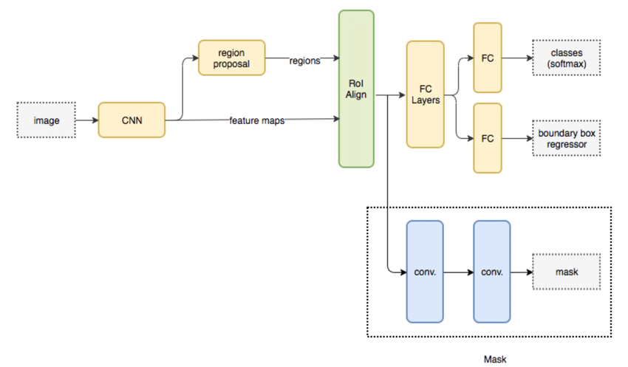
VVIT, ICRASTEM-2K23 Live Capturing Based Image segmentation using Mask R-CNN
Contd
Object Detection: Object detection is the combination of both classification and localization. This is useful to tell what objects are in the image and where the objects are in the image. To generate the bounding boxes around the object it uses classification.
AAAAAA
Fig-1: Architecture of Mask R-CNN
Article ID: ic2k23-it-022 11/04/2023 -7-

Slide 8
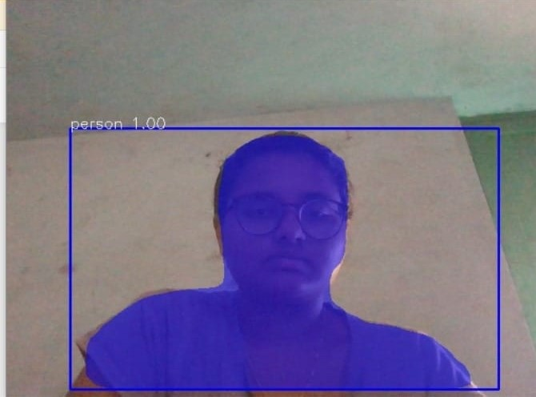
VVIT, ICRASTEM-2K23 Live Capturing Based Image segmentation using Mask R-CNN
RESULTS
Article ID: ic2k23-it-022 11/04/2023 -8-

Slide 9
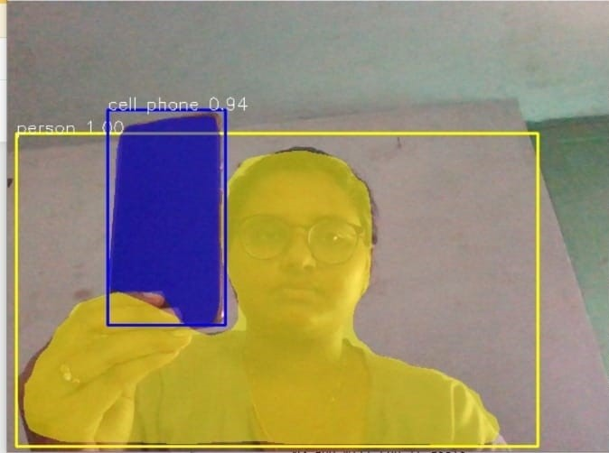
VVIT, ICRASTEM-2K23 Live Capturing Based Image segmentation using Mask R-CNN
RESULTS
Article ID: ic2k23-it-022 11/04/2023 -9-

Slide 10
VVIT, ICRASTEM-2K23 Live Capturing Based Image segmentation using Mask R-CNN
CONCLUSION
In conclusion, we have developed a new method for image segmentation which is using Mask R-CNN by this the objects in the image are identified.
Along with the object identification, it also results in the class, object mask, and bounding box coordinates of the object.
The Proposed system is an image segmentation model using a regional convolutional neural network for segmenting live captured images.
Article ID: ic2k23-it-022 11/04/2023 -10-

Slide 11
VVIT, ICRASTEM-2K23 Live Capturing Based Image segmentation using Mask R-CNN
LIMITATIONS
However, the Mask R-CNN is a powerful model, but it also contains some limitations.
They are :
Object Obstruction: When an object is covered by another object fully or partially, this can cause inaccurate or missing object instances as result.
Training Data: As most of the deep learning models require large amounts of data for training which results in better performance, Mask R-CNN also falls under these models. This can be difficult because some of the domains do not contain large data sets.
Article ID: ic2k23-it-022 11/04/2023 -11-

Slide 12
VVIT, ICRASTEM-2K23 Live Capturing Based Image segmentation using Mask R-CNN
FUTURE SCOPE
As Mask R-CNN is the most accurate and flexible model for image segmentation. To improve its performance and capabilities there is an enhancement.
They are:
Domain Adoption: As already mentioned in the drawbacks some of the domains may not have much training dataset. This could affect the performance of the model, to overcome this problem domain adoption is used. Which means taking knowledge from one domain and using it in other domains.
Weakly supervised learning: Currently, Mask R-CNN requires annotated data for training, which can be time-consuming and expensive. Future research could explore weakly supervised learning techniques, where the model can learn from less annotated or noisy data, reducing the amount of human effort required for training.
Article ID: ic2k23-it-022 11/04/2023 -12-

Slide 13
VVIT, ICRASTEM-2K23 Live Capturing Based Image segmentation using Mask R-CNN
REFERENCES
[1] F. Meyer, An overview of morphological segmentation. International Journal of Pattern Recognition and Artificial Intelligence, vol. 15, no. 7, pp. 1089-1118,2001.
[2] J-M. Morel and S. Solimi, Variational Methods in image segmentation; Birkhauser Boston, 1995.
[3] D. Mumford and J. Shah, “Boundary Detection by Minimizing functionals” Image Understanding, 1988.
[4] P. Salembier and F. Marques,“Region based representations of image and video: Segmentation tools for multimedia services”, IEEE Transacations on circuits and systems for video technology, vol. 9, no.8, pp. 11471167, Dec. 1999
[5] J. Serra, “Connectivity on complete lattices”, Journal of Mathematical Imaging and Vision 9, pp. 231-251, 1998.
Article ID: ic2k23-it-022 11/04/2023 -13-

Slide 14
VVIT, ICRASTEM-2K23 Live Capturing Based Image segmentation using Mask R-CNN
ACKNOWLEDGEMENTS
The success and final outcome of our project requires a lot of guidance and assistance from many people and we are extremely privileged to have got this all along the working of our project. All that we have done is only due to such supervision and assistance and we would not forget to thank them. We express our sincere gratitude to Professor & HOD Dr. A. KALAVATHI, for her constant encouragement, motivation and faith by offering different places to look to expand our ideas. We would not forget to thank our Project Coordinator Ms. K. Rajyalakshmi for her encouragement and more over for her timely support and guidance. We owe a deep gratitude to our project Guide Mr. K. Jeevan Rathnakar, who took keen interest in our project work and guided us all along by providing all the necessary information for developing a good system. We are thankful to and fortunate enough to get constant encouragement, support and guidance from all teaching staffs of our department which helped us in our project work.
Article ID: ic2k23-it-022 11/04/2023 -14-

Slide 15
Thanks to All ……
[ICRASTEM-2K23]
Question & Answers ?

